Slide 1
Milestone 1
June, Wen Hui, Hui Ting

Slide 2
Table of Content
Introduction of Graph
Graph 1 - Problems
Introduction of Graph 2
Graph 2 - Problems
Graph 1 - Solution
Graph 1 - Solution 2
Graph 2 - Solution

Slide 3
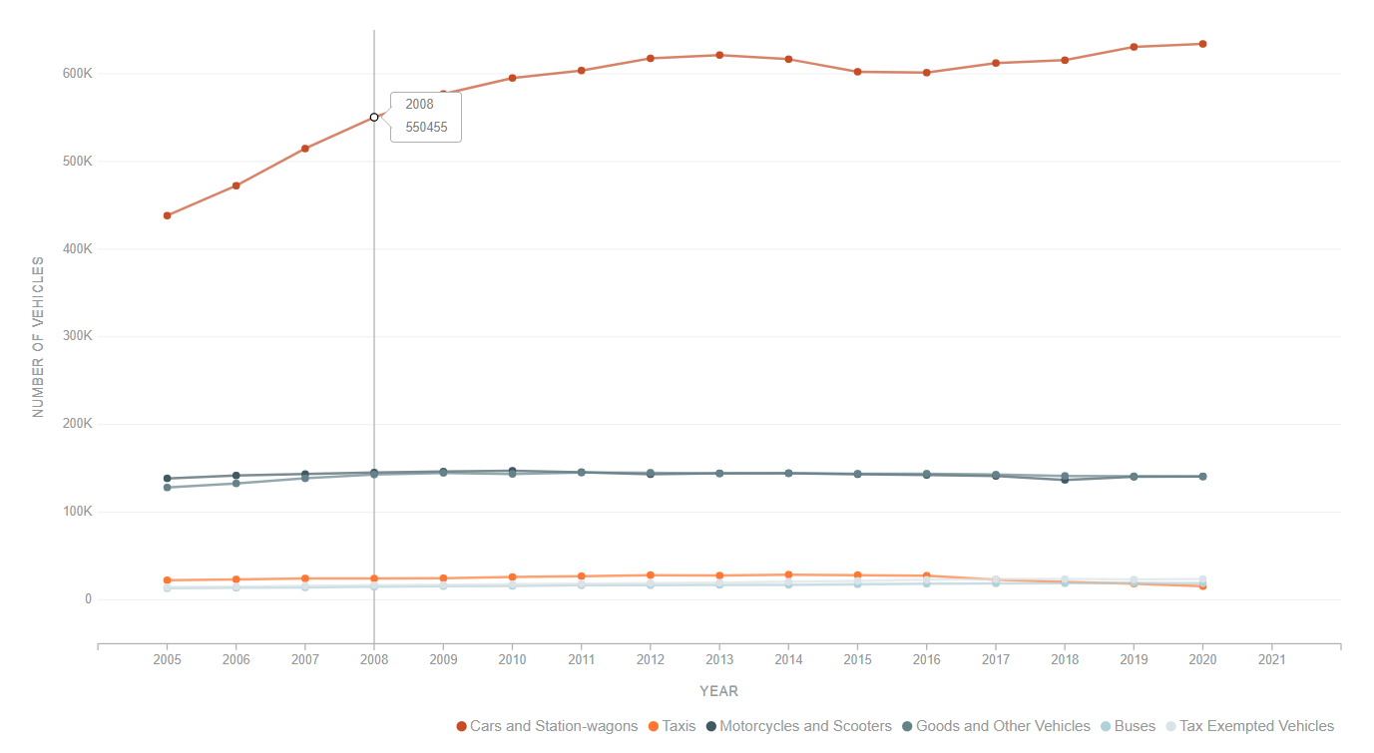
Introduction of Graph
Annual Motor Vehicle Population by Vehicle Type
Represents the growth in the number of different vehicles over the years in Singapore.
Created from dataset collated by SG government from January 2005 to December 2020.
The categories covered in this graph includes:
Cars and station wagons
Taxis
Motorcycles and Scooters
Goods and other vehicles
Buses
Tax Exempted Vehicles

Slide 4
Graph 1 - Problems
Annual Motor Vehicle Population by Vehicle Type
Unsure what kind of data to focus on (what is actually trying to tell): Not much interactivity for the users
Stacked area charts: Does not have a clear message for user. Based on thickness different between each lines
Bad Accuracy Perception: The chart only showed growth in cars and station wagons, while other vehicles seem to remain the same, but this is false.
Color Scale (Misleading representation): The choice of color mixed some of the scales together, making it almost indifferentiable. (The colors of negligible contrast)

Slide 5
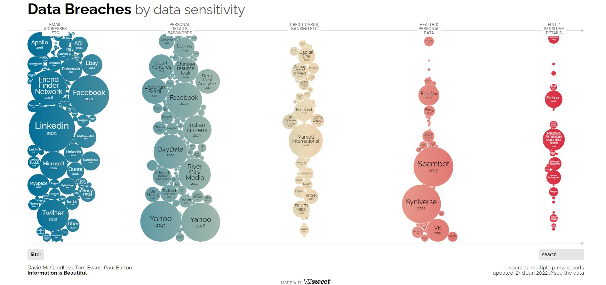
Introduction of Graph 2
Display different type of data breaches
Based on amount of data loss
Company
Accumulation of all the data breach
incidents reported in the news over the years.
The categories covered in this graph includes:
Email addresses
Personal details & Passwords
Credit Cards , Banking
Health & Personal Data
Full / Sensitive Details

Slide 6
Graph 2 - Problems
Unclear xScale and yScale
Difficult for the viewer to comprehend (Too many variables)
No clear accurate value to show the severity of visual on severity
Due to the smaller circle are almost invisible
No value is displayed
Misleading representation (Bad categories)
Circle size does not represent impact of the value of the data
Example : Smaller value within the graphic represented as small circle but compare to real life value ( the amount of data loss) may equal to a few countries cities.
Color Scale (Color Disproportionates)
Intensity of the colors does not represent the severity
Example : the transition from the brighter blue and green to pale yellow
Color selection does not represent the severity of the category
Notes:
https://informationisbeautiful.net/visualizations/worlds-biggest-data-breaches-hacks/#bysensitivity

Slide 7
Graph 1 - Solution
Bar Graph - Show vehicle trend throughout the years clearly
Use highlight or animate to focus on the bar graph (User interactivity)
Have a clear display of the different gap between each lines: Can be clear labelling or tooltips to display more information
Change colors of both “Motorcycles and Scooters” and “Goods and Other Vehicles” so that they can be easily differentiated.

Slide 8
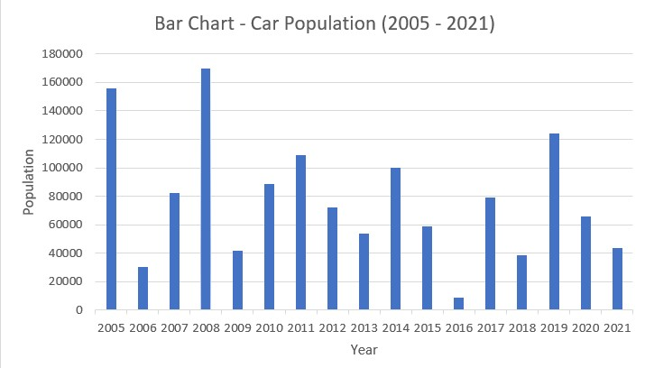
Graph 1 Solution - Bar Graph (By Category)
Total of 6 car categories showcased in the line graph showed little due to large value differences across the categories.
Differentiating these data across 6 bar graphs - Allows the change in the number of vehicles across the years for each category to be more prominent.
The tooltips will also aid in providing the user more information regarding the amount of vehicles for that year.

Slide 9
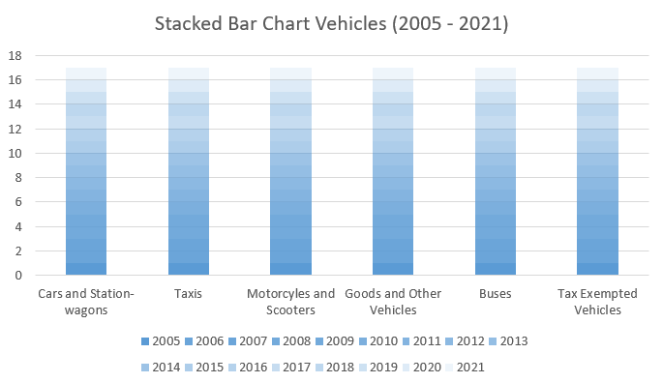
Graph 1 Solution - Stacked BarChart (Comparison)
Clearly showcases the growth of the number of vehicles across the years for each category. E.g. stagnant increase vs obvious upward trend.
Allows for more prominent comparison across the categories, such as the difference between each category.

Slide 10
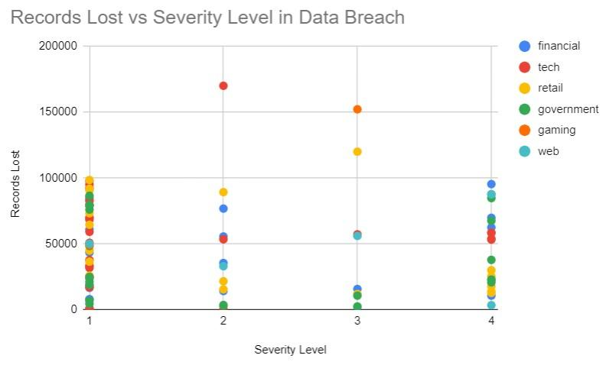
Graph 2 Solution - Scatter Plot
X- axis: Priority Level - email addresses, personal addresses and passwords)
Y-axis: Impact - The amount of data records lost
Color code: Economic Sector - Group to a small number of colors
Hover Tooltip: Information - Company and year

